Slide 1
Employee Data Analysis using Excel
STUDENT NAME : ANUSHA A
REGISTER NO : F84B86F87F6554D9ACE4FDE480A3F68E,312208822
DEPARTMENT : B.COM (GENERAL)
COLLEGE : MEENAKSHI COLLEGE FOR WOMEN

Slide 2
PROJECT TITLE
Employee Performance Analysis Based on Department, Gender and Salary using Excel

Slide 3

AGENDA
Problem Statement
Project Overview
End Users
Our Solution and Proposition
Dataset Description
Modelling Approach
Results and Discussion
Conclusion
3/21/2024 Annual Review

Slide 4

PROBLEM STATEMENT
To analyze employee performance across different departments, genders, and salary levels to identify trends, disparities, and areas for improvement in organizational practices. This analysis aims to support the organization’s goals of enhancing employee performance while fostering an inclusive and equitable workplace.

Slide 5

PROJECT OVERVIEW
Analyzing performance metrics through the lenses of department, gender, and salary can provide valuable insights that help drive strategic initiatives, improve employee engagement, and promote diversity and equality in the workplace. By addressing potential disparities and promoting equitable practices, the organization can cultivate a more motivated and high-performing workforce.

Slide 6

WHO ARE THE END USERS?
● HUMAN RESOURCE DEPARTMENTS
● MANAGEMENT AND LEADERSHIP
● TEAM LEADERS AND SUPERVISORS
● EMPLOYEES
● EXECUTIVE LEADERSHIP
● BUSINESS ANALYSTS
● RECRUITERS

Slide 7

OUR SOLUTION AND ITS VALUE PROPOSITION
PIVOT TABLE – SUMMARY OF EMPLOYEE PERFORMANCE
BAR DIAGRAM – FINAL REPORT

Slide 8
Dataset Description
EMPLOYEE DATA SET – NAN MUDHALVAN PORATAL 9 FEATURES IN EXCEL: EMPLOYEE ID – ALPHANUMERIC (TEXT) NAME – ALPHABETICAL (TEXT) GENDER – ALPHABETICAL (TEXT) DEPARTMENT – ALPHABETICAL (TEXT) SALARY - NUMERICAL START DATE – ALPHANUMERIC (TEXT) FTE - NUMERICAL EMPLOYEE TYPE – ALPHABETICAL (TEXT) EMPLOYEE LOCATION – ALPHABETICAL (TEXT) 3 FEATURES USED: DEPARTMENT – ALPHABETICAL (TEXT) SALARY - NUMERICAL GENDER – ALPHABETICAL (TEXT)

Slide 9

THE "WOW" IN OUR SOLUTION
This analysis offers a clear understanding of how department. Gender and salary influence employee performance. By addressing the identified trends and implementing the recommended strategies, the organization can foster a more effective, supportive, and performance-driven work environment.
3/21/2024 Annual Review
9

Slide 10
MODELLING
STEP-1
DOWNLOAD THE EMPLOYEE DATASET AND OPEN THE EMPLOYEE DATASET IN EXCEL.
STEP-2
SELECT THE ENTIRE DATA AND CLICK ON INSERT AND CLICK ON PIVOT TABLE TO CREATE PIVOT TABLE.
STEP-3
DRAG THE NEEDED DATA AND CREATE A PIVOT TABLE.
10

Slide 11
STEP-4
SELECT THE PIVOT TABLE AND CLICK ON INSERT.
STEP-5
NOW CLICK ON THE CHART THAT YOU WANT.
STEP-6
THE CHART IS CREATED.

Slide 12
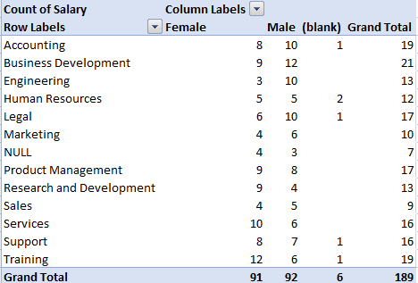
RESULTS 1. TABLE
12

Slide 13
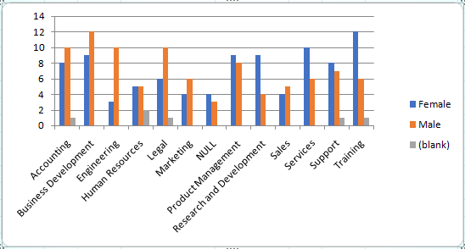
2. BAR DIAGRAM

Slide 14
Conclusion
The analysis of employee performance, segmented by department, gender, and salary, has provided valuable insights into how these factors interact and influence performance outcomes within the organization. This analysis underscores the importance of departmental strategies, equitable performance management, and the nuanced relationship between salary and performance.

